Slide 1
Rate
GROWTH AND DECAY

Slide 2
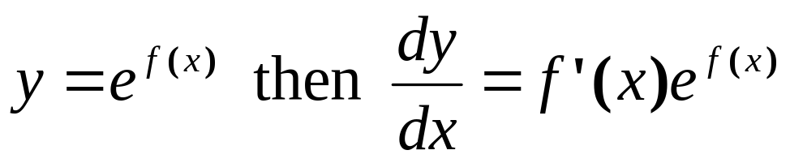
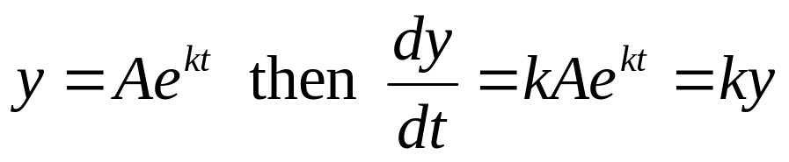
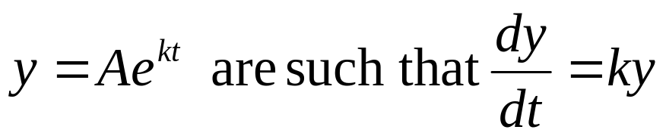
Exponential Functions
In the earlier chapter, we found that:
Thus, if
Therefore, for an exponential function, the rate of change of y with respect to t is proportional to y itself
The functions of
that make them suitable for describing growth and decay situations

Slide 3
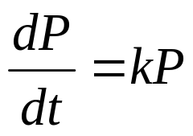
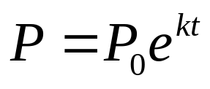
Exponential Functions
Any growth or decay situation in which the rate of change of the population is proportional to the population itself i.e. can be modeled by an exponential equation
of the form
P0 is the value of P when t = 0 (initial population)
k is the growth or decay rate of y
k > 0 : increasing/ growth rate of y
k < 0 : decreasing / decay rate of y

Slide 4
Exponential Functions
Example 1:
Demographers monitored a particular country’s population
growth over a 20 year period from 1970, when the population
was 2 000 000. They found that the population was
continuously growing with the instantaneous rate of increase in
the population per year, dP/dt, always close to 0.05P.
Estimate the population of this country at the end of the 20 year period
If this pattern of growth continues, estimate the population in the year 2025.
[5400000, 31000000]

Slide 5
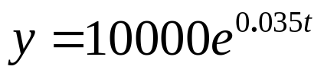
Exponential Functions
Example 2:
Solve the differential equation dy/dt = ky given that the value of y double every 20 seconds and that the initial value of y is 10000.
Example 3:
A particular radioactive isotope decays
continuously at a rate of 9% per year. One
kilogram of this isotope is produced in a
particular industrial process. How much remains
undecayed after 20 years [165 grams]

